Slide 1







CATFISH!
Meet Catfishes Around the World
Rae Bridgman
www.raebridgman.com

Slide 2




































































Fish & Sphinx
Wil Wychwood’s magical medallion weighs heavily on him. For once, he would just like to live a normal life. Tired of bearing the burden of the Serpent’s Chain secret society, he plans to toss the medallion into the rising river waters. But when mists reveal a new mystery, cousins Wil and Sophie tumble into the secret realm of Catfysh, the Spirit of the River, and a plot to destroy the most magical building in Canada.
www.raebridgman.com

Slide 3

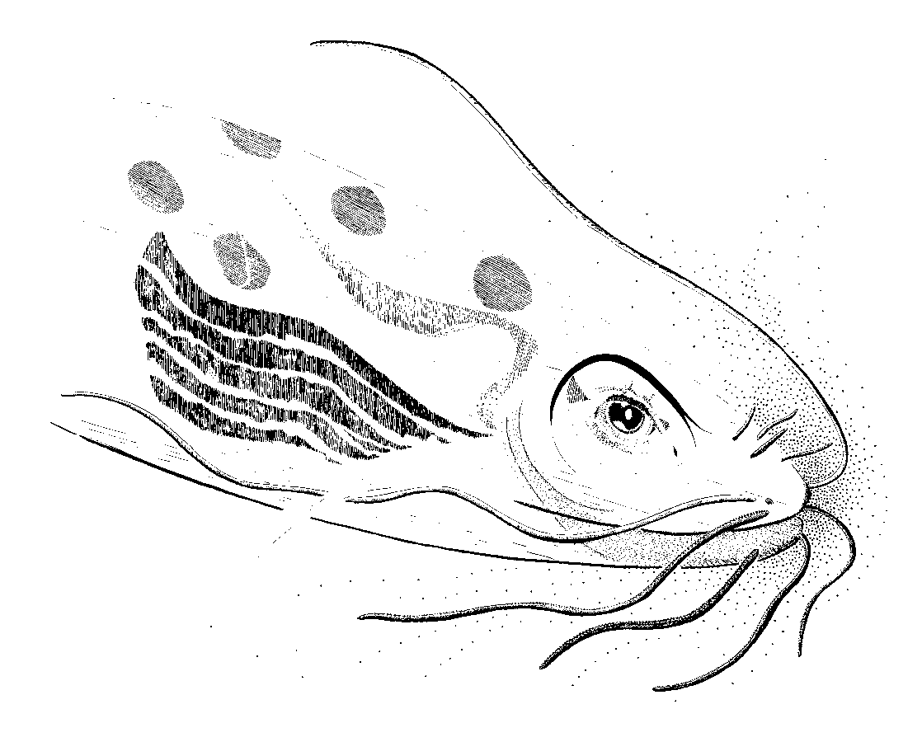








































































Catfysh
“The fog swirled around the children, holding them close. A splash by the river startled them both and they turned to see what it was. There, standing before them, was a woman wearing
long, silvery robes. Her hair was matted and whiskers trailed from her chin. But it was her eyes that were the most startling. Pale and wide-set, they glimmered like two moons” [from Fish & Sphinx, by Rae Bridgman]
Illustration of catfish © 2010 Rae Bridgman
www.raebridgman.com

Slide 4
DID YOU KNOW?
There are 34 families and about 2400 species of catfish in the world. Only one family, the North American Freshwater Catfishes, Family Ictaluridae, is found in Canada.
Catfish vary from less than 5cm long to almost 5m long The largest strictly freshwater fish in the world is a catfish.
Catfish use their swim bladders as eardrums, and can taste with their belly and whiskers (barbels).
Most catfish have a spine at the leading edge of the dorsal and each pectoral fin, and can inflict a painful sting. A few are dangerously venomous. The sting of an Australian catfish can be fatal, and a family of South American Catfishes are parasitic on other fish.

Slide 5
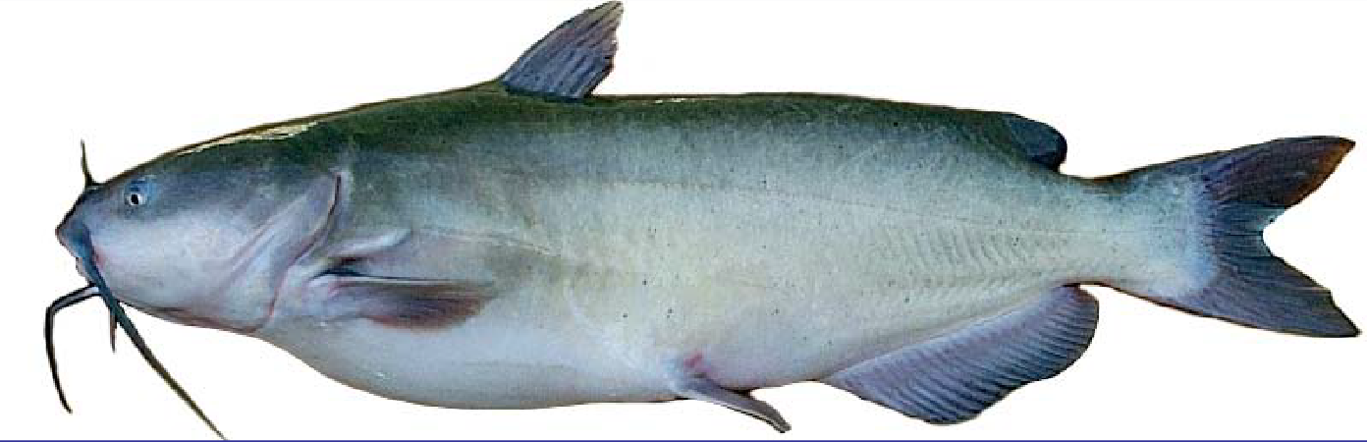
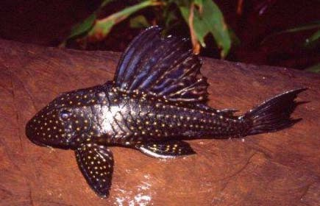
BASIC CATFISH STRUCTURE
BARBELS (WHISKERS)
NO SCALES
SPINES
BONY PLATES
www.raebridgman.ca

Slide 6
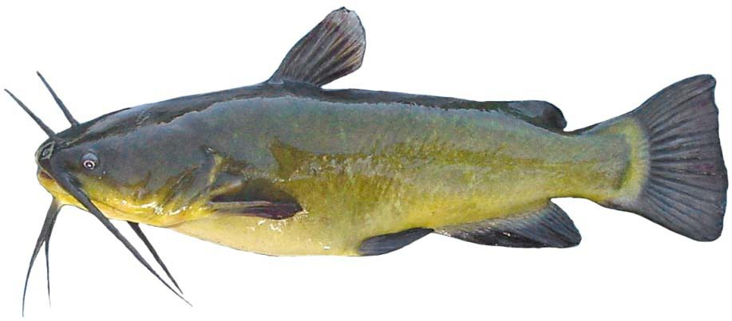
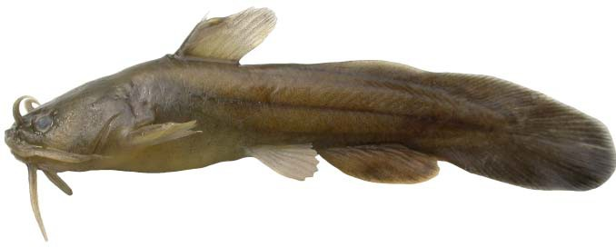
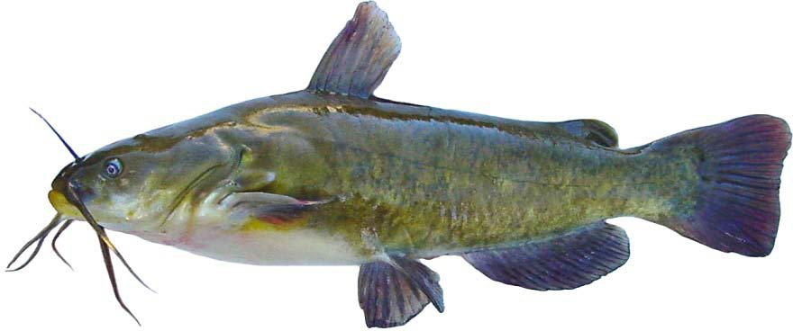
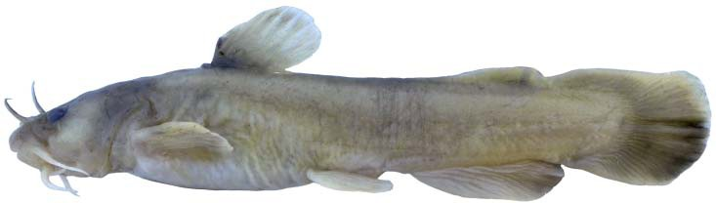
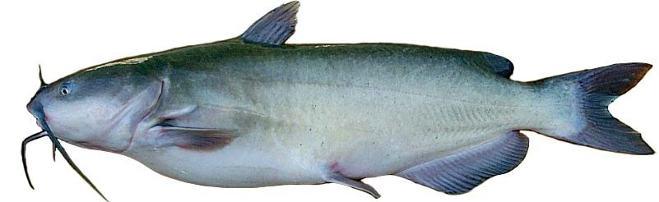
Manitoba’s Catfishes
black bullhead, Ameiurus melas
tadpole madtom, Noturus gyrinus (venomous)
stonecat, Noturus flavus
brown bullhead, Ameirus nebulosus
channel catfish, Ictalurus punctatus

Slide 7
CAVE-DWELLING ICTALURIDS

Slide 8
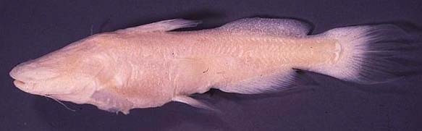
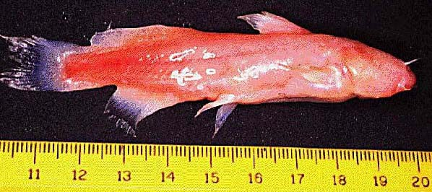
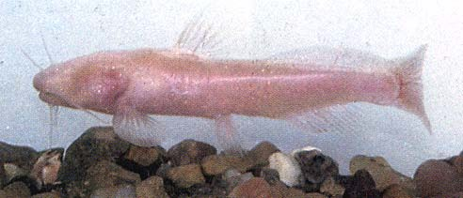
Widemouth blindcat, Satan eurystomus, known from 5 artesian wells near San Antonio, Texas, USA
Texas blindcat, Trogloglanis pattersoni, known from 5 artesian wells near San Antonio, Texas, USA
Mexican blindcat, Prietella phreatophila, known only from wells near Sierra de Santa Rosa, Coahuila, Mexico

Slide 9
THE LARGEST CATFISHES
NORTH AMERICA

Slide 10
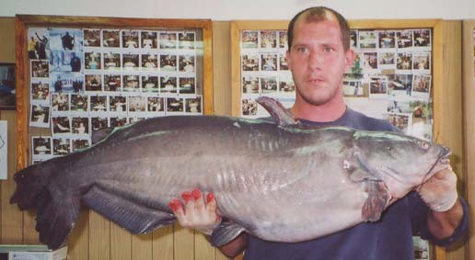
The largest North American Catfish, the blue catfish, Ictalurus furcatus. Up to about 1.7 m, and about 70 kg. Mississippi / Missouri / Ohio Basin, south to Guatemala

Slide 11
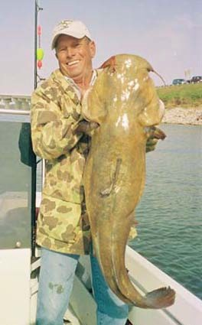
Flathead catfish, Pylodictis olivaris. Up to about 1.6 m, and 56 kg. North America, from Lake Erie, through Mississippi / Ohio / Missouri Basin and Gulf Coast. North American Freshwater Catfishes, Family Ictaluridae

Slide 12
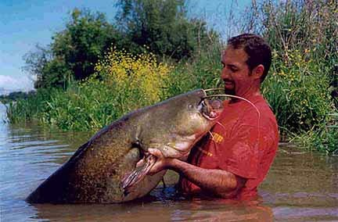
Flathead Catfish or Internet Hoax?

Slide 13











It’s a hoax!
The photo on the previous slide is actually an internet hoax. Flathead catfish are native to the Mississippi, Missouri and Ohio river systems, and the Southern Atlantic and Gulf Coastal drainages in the U.S.A.
In the south, people catch nest-guarding males by wading or swimming along cut banks on river shorelines, and feeling for a fish in the cavities under the banks. When they feel one, they grab it in the gill openings and wrestle it aboard a boat. Flathead cats grow to just over 50 kg.
The fish in the picture is a wells catfish, a Eurasian species growing to approx. 250 kg. Apparently, they too like cavities in cut banks, and Europeans catch them in the same way as Americans catch flathead catfish.
Several years ago, there were a number of pictures of wells catfish on the internet and in the newspapers that were (wrongly) alleged to be world record flathead cats. The picture in the previous slide was one of those circulated on the internet that was supposed to be a record flathead cat.

Slide 14
NORTHWESTERN ASIA

Slide 15
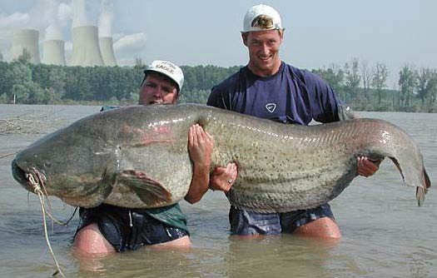
Wels catfish: World’s largest catfish, Silurus glanis. Grows to a length of about 4.75 m, and a weight of about 250 kg. Found in Eurasia from the Aral Sea to the upper Danube River, and introduced west to Britain. Sheatfishes, Family Siluridae
[Source: http://xvella.free.fr/photos/00000713.jpg>. Date accessed: 30 January 2010]

Slide 16
SOUTHEASTERN ASIA

Slide 17
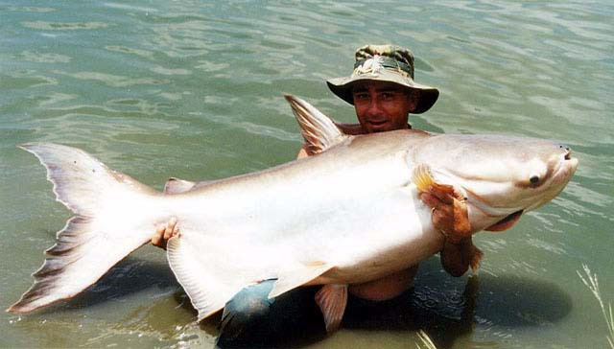
World’s largest strictly freshwater fish, Mekong Giant Catfish, Pangasianodon gigas, Up to 3 m. long, and 350 kg. Shark Catfishes, Family Pangasiidae. Juveniles have pads of small teeth on their jaws and feed on aquatic insects. The teeth are lost as they grow, and larger fish feed only on algae.

Slide 18






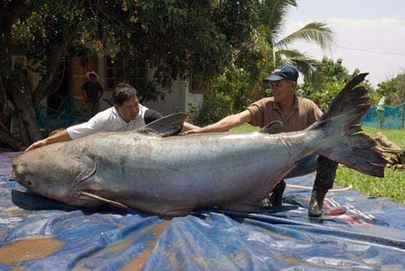
Mekong Giant Catfish
This fish was caught on May 1, 2005 from the Mekong River in Thailand. It was 2.7 m long, and weighed 393 kg.
[Source: <http://www.smh.com.au/news/world/anglers-catch-293kg-monster- fish/2005/06/30/1119724729978.html>. Accessed 30 January 2010.]

Slide 19
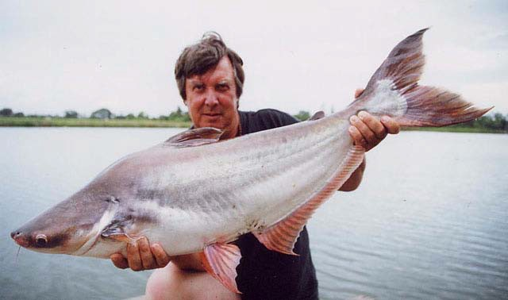
Sutchi catfish, Pangasius hypophthalmus. Aquacultured sutchi catfish are sold as frozen fillets
[Source: http://fishbase.ifm-geomar.de/Summary/speciesSummary.php?id
=14154&lang=portuguese_po>. Accessed 30 January 2009.]

Slide 20
INDIAN SUBCONTINENT

Slide 21
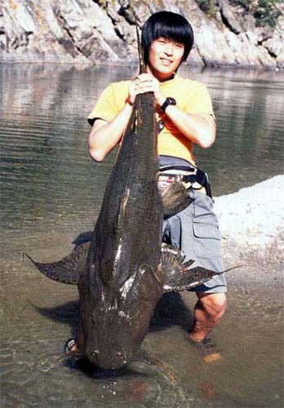
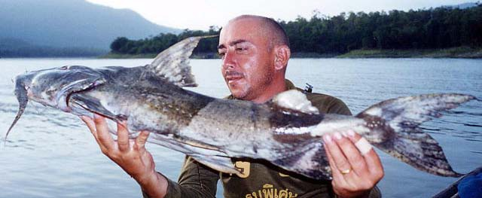
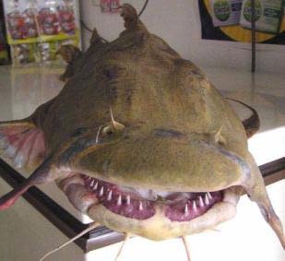
Goonch, Bagarius yarrelli, Length to about 2 m. Indus and Ganges basins, India. Sisorid catfishes, Family Sisoridae

Slide 22
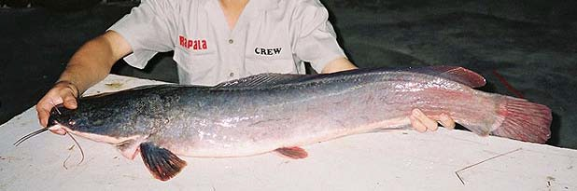
North African catfish, Clarias gariepinus. Most of Africa and adjacent Middle East. Grows to about 1.7 m and 60 kg. Air breathing catfishes, Family Clariidae

Slide 23
SOUTH AMERICA

Slide 24
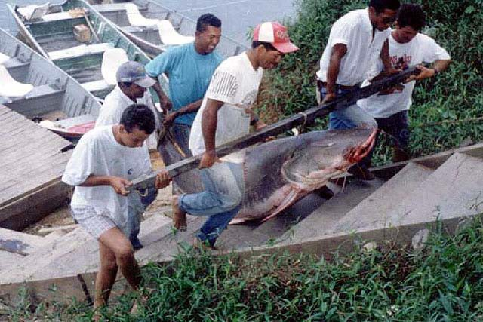
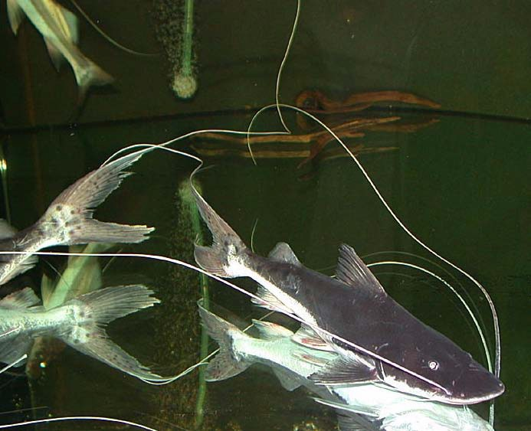
Kumakuma or Paraiba catfish, Brachyplatystoma filamentosum, to 3.6m long and 200kg. South America, Amazon and Orinoco Basins. Long- Whiskered Catfishes, Family Pimelododae

Slide 25
MARINE CATFISHES
www.raebridgman.ca

Slide 26
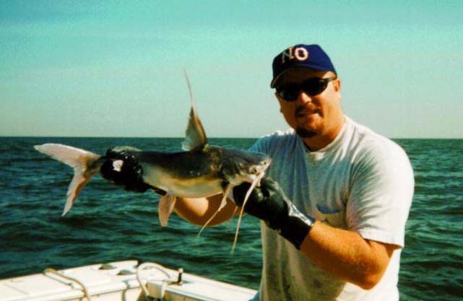
Gafftopsail Catfish, Bagre marinus. Gulf of Mexico and Caribbean to northern South America. Up to 60cm and 4.5kg. Sea Catfishes Family Ariidae

Slide 27
ARMOURED CATFISHES of SOUTH AND CENTRAL AMERICA

Slide 28
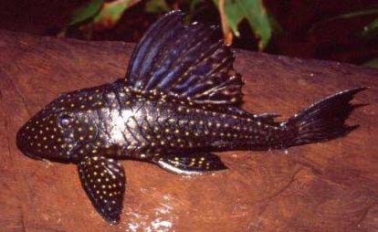
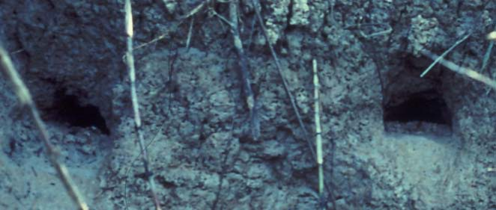
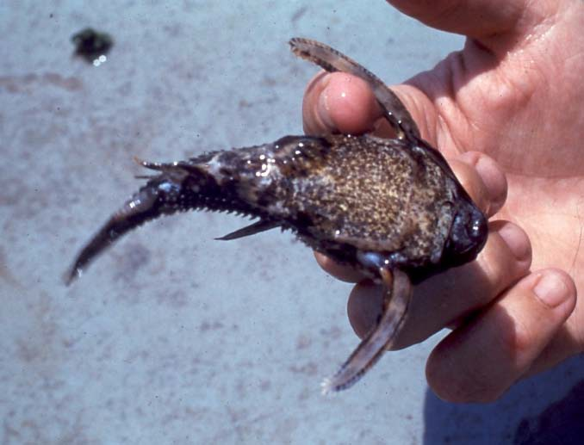
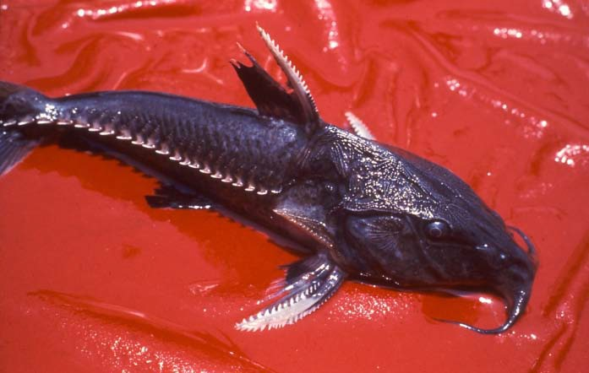
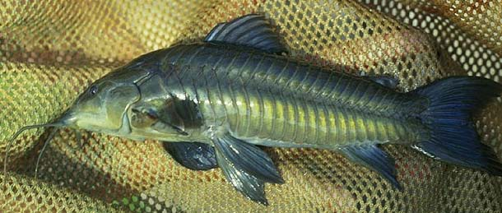
Suckermouth armoured catfishes, Loricariidae
Thorny catfishes,
Doradidae
Callichthyiid armoured catfishes, Callichthyidae

Slide 29
CATFISHES
with NASTY SUPRISES

Slide 30
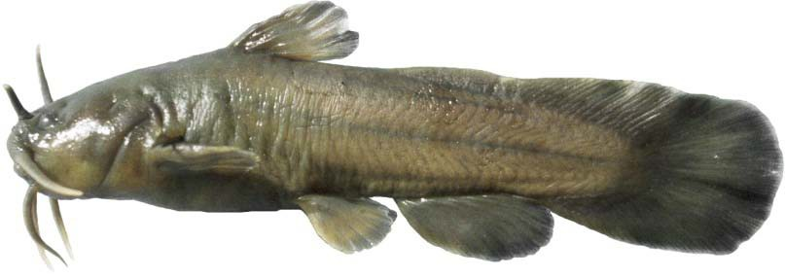
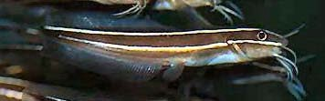
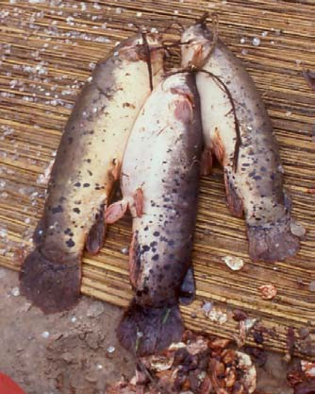
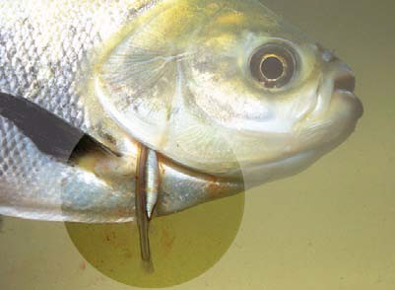
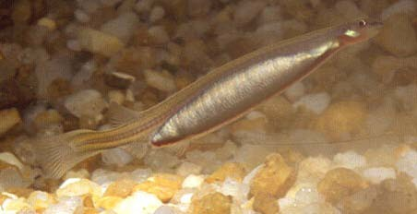
Striped eel catfish, venomous (lethal), marine, Indo-Pacific
Tadpole madtom, venomous, Manitoba
Electric catfish, electrogenic, most of tropical Africa
Candiru, parasitic, Amazon & Orinoco basins, South America

Slide 31
Acknowledgements
My thanks to Ken Stewart for having granted permission to use material he collected for a presentation about catfish for CATFISH! Many of the images were drawn from the internet; I have cited relevant URLs, where these were available.
Dr. Kenneth Stewart (1936-2011), herpetologist and ichthyologist, was Professor Emeritus of Zoology at the University of Manitoba, and a nationally recognized expert on freshwater fish. He was co-author (with Douglas Watkinson) of The Freshwater Fishes of Manitoba (U of M Press, 2004).

